Slide 1
Does The U.S. Government Provide Enough Funding to Families In Need of Food?
Will Greene

Slide 2
Hunger in the U.S.
1 in 6 people live in hunger
1 in 4 children live in hunger
Hunger? What exactly is it?

Slide 3
Effects
Learning
Development
Productivity
Family Life
Health

Slide 4
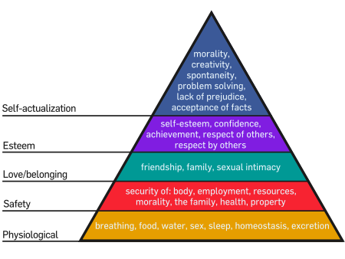
Maslow’s Hierarchy of Needs

Slide 5
Programs
Federal/State
Food Stamps
SNAP
Department of Agriculture

Slide 6
Is This Enough?
Publicity
Qualifications
Spending/Organization

Slide 7
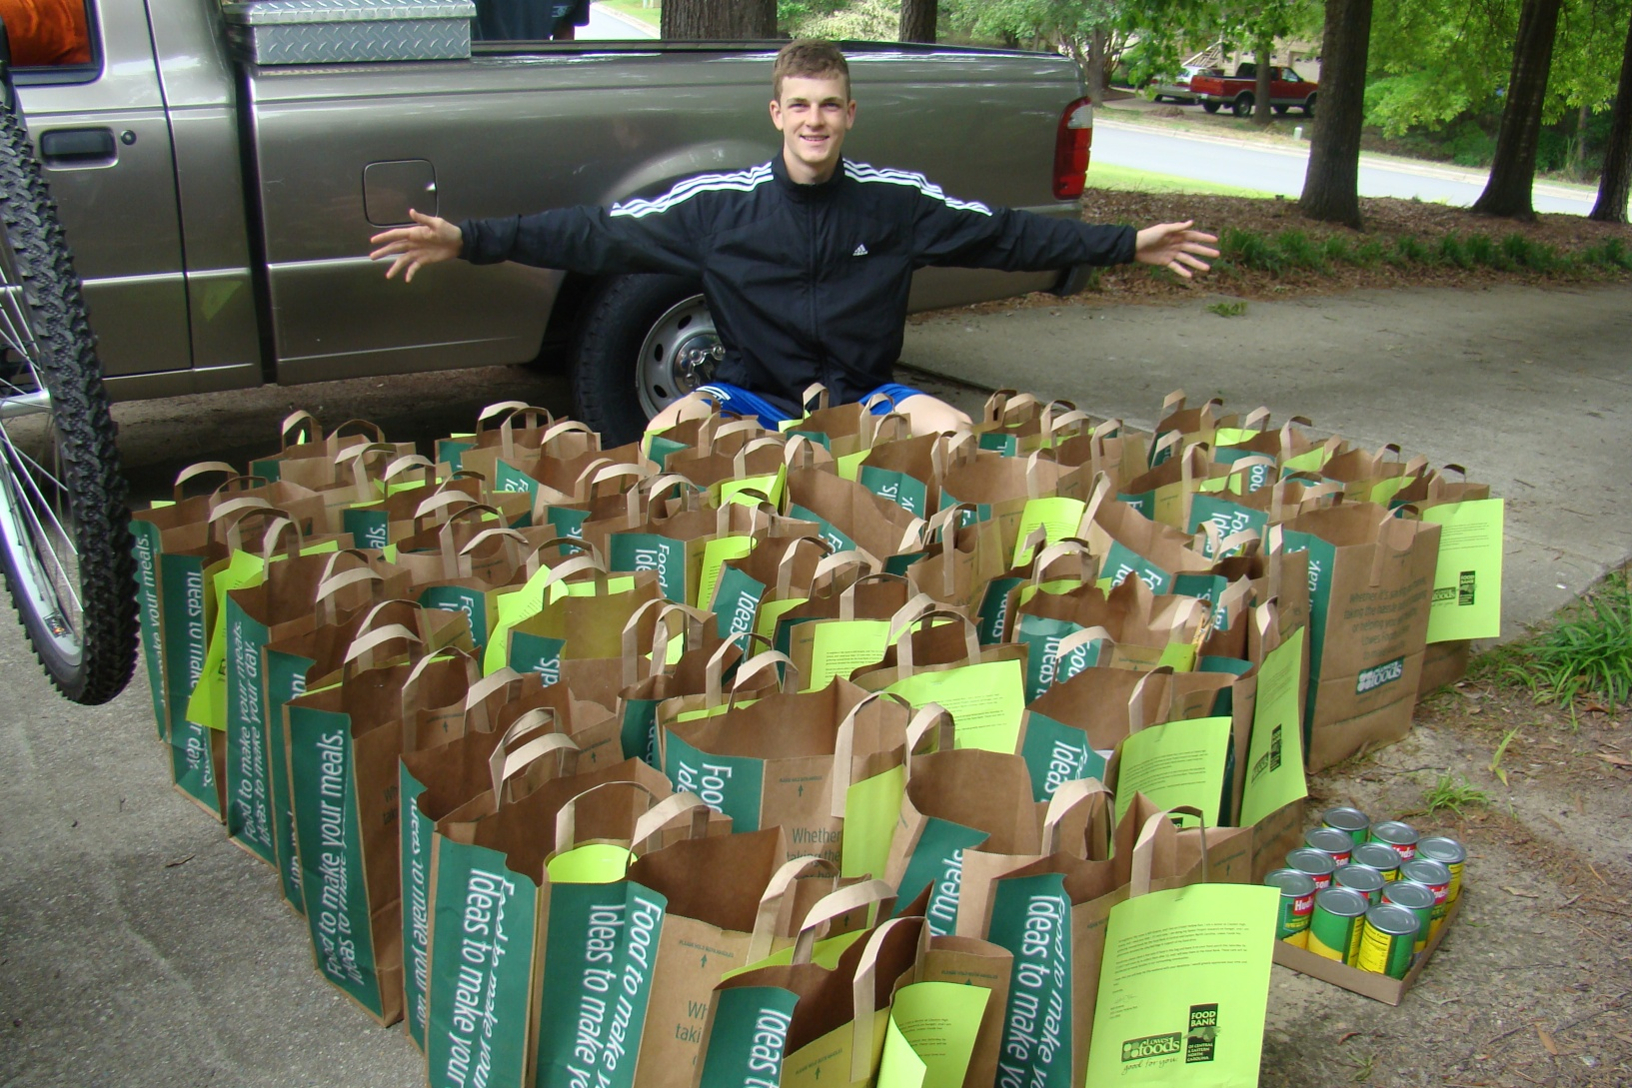
Product

Slide 8
My Mentor
John Foister
Department Manager of the Food Bank of Eastern and Central NC
Preacher

Slide 9
Product
100 bags
Canned foods
Pick up
Food Bank drop-off

Slide 10
Stats/Facts
Over 50% participation
438 lbs. of canned goods

Slide 11
Problems
Time
Planning
Dogs

Slide 12
What I Learned
Planning
Schedule
Real-World
Participation

Slide 13
Benefits
Writing (Letter)
Speaking
Organization

Slide 14

Questions?

Slide 15
Thank You!

